Slide 1

Enzyme-Constrained GEMs of microbial and human metabolism

Slide 2
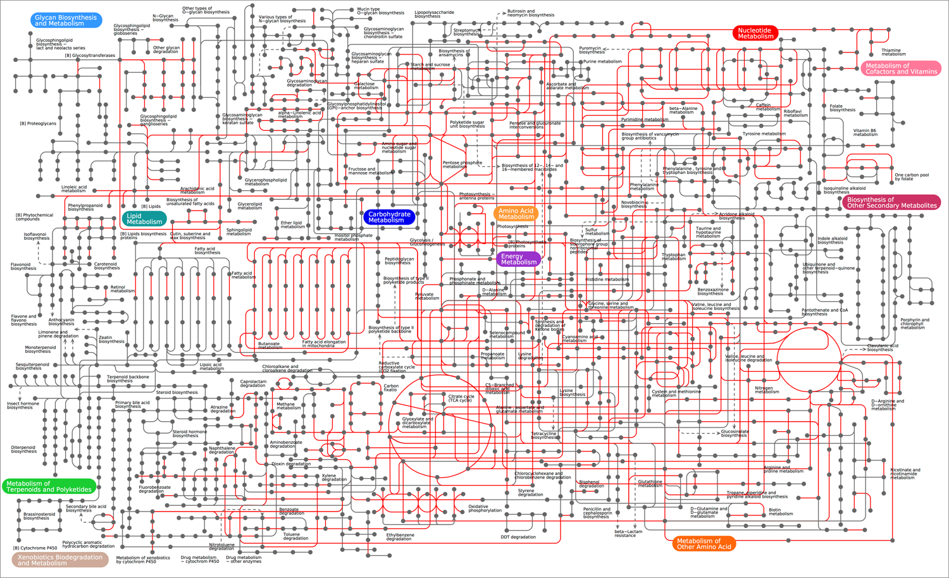
Enzyme limitations in metabolism
Metabolism:
At the core of cellular function
Huge
Highly constrained
Enzyme limitations:
Each metabolic reaction is limited by its corresponding enzyme
Enzymes have different catalytic activities → pathways will have different limitations
We want to model them!

Slide 3
Enzyme limitations in metabolism

Slide 4
Enzyme limitations in metabolism
Not all pathways have the same limitations!!

Slide 5
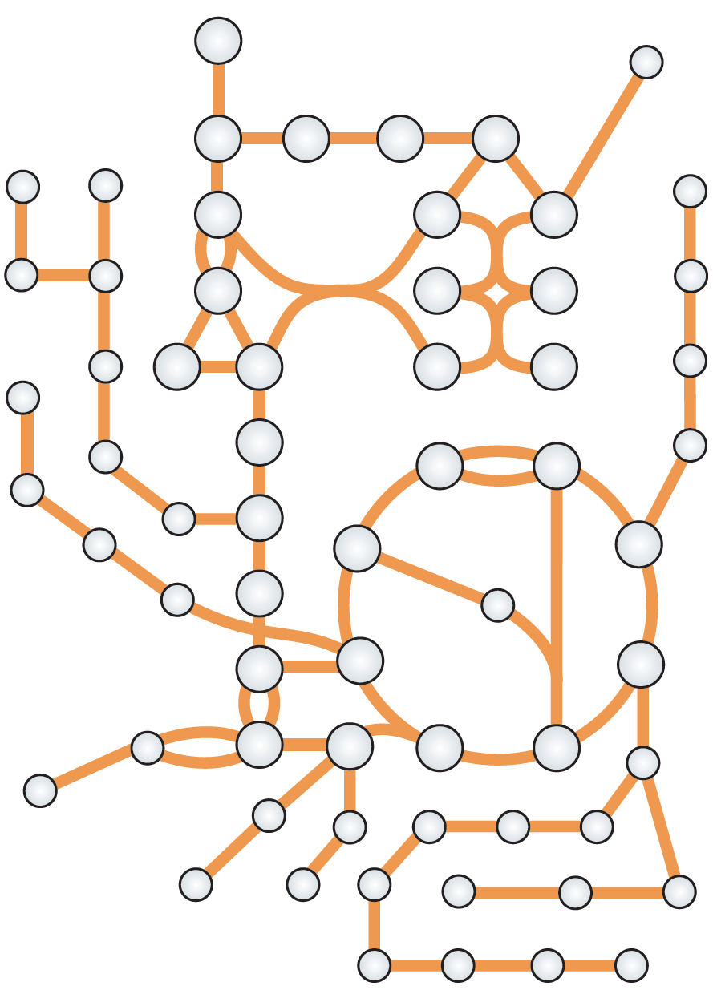
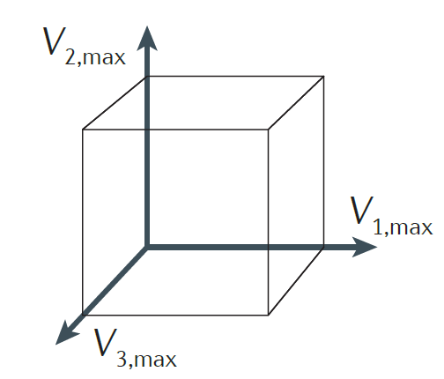
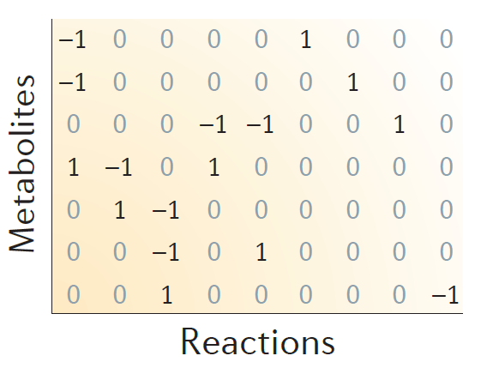
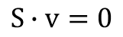
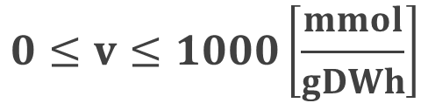
Modeling metabolism
3 easy steps to create a GEnome-scale Model (GEM) of metabolism:
1. Get network
2. Construct stoichiometric matrix (S)
3. Define constraints
$$S∙v=0$$
Some fluxes can be measured experimentally (i.e. exchange fluxes), but for most of them we assume:
$$0≤v≤1000\left[\frac{mmol}{gDWh}\right]$$
Is this realistic?
Notes:
~1000 people/door s

Slide 6
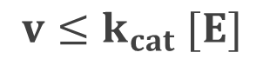
Modeling enzyme limitations in metabolism
Relationship between enzyme and reaction:
Flux of reaction
[mmol/gDWh]
$$v≤k_{cat} [E]$$
Concentration of enzyme [mmol/gDW]
Turnover number [1/h]

Slide 7
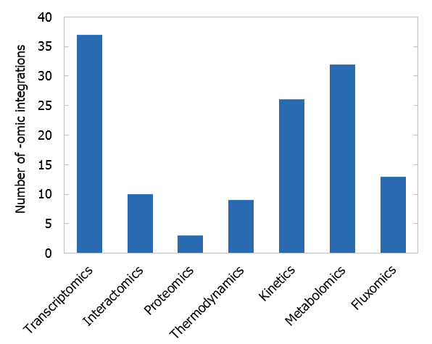
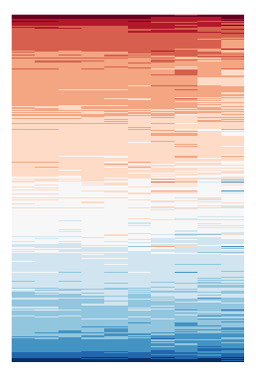
Modeling enzyme limitations in metabolism
Relationship between enzyme and reaction:
Flux of reaction
[mmol/gDWh]
$$v≤k_{cat} [E]$$
Concentration of enzyme [mmol/gDW]
Turnover number [1/h]
However: No available method for directly connecting proteomics to GEMs
Proteomics
Metabolism
Sánchez, B. J., & Nielsen, J. (2015). Integrative Biology, 7(8), 846–858. https://doi.org/10.1039/c5ib00083a

Slide 8
Taking enzymes into account
Nilsson, A., & Nielsen, J. (2016). Scientific Reports, 6. https://doi.org/10.1038/srep22264

Slide 9
Taking enzymes into account
Nilsson, A., & Nielsen, J. (2016). Scientific Reports, 6. https://doi.org/10.1038/srep22264

Slide 10


Taking enzymes into account
Reproducing the Crabtree effect
Metabolic efficiency
(low substrate)
5 GLU + 30 O₂
100 ATP + 30 CO₂
~240 mg of protein
Catalytic efficiency
(Low enzyme)
50 GLU
100 ATP + 100 ETH + 100 CO₂
~120 mg of protein

Slide 11
Going into Genome-Scale

Slide 12

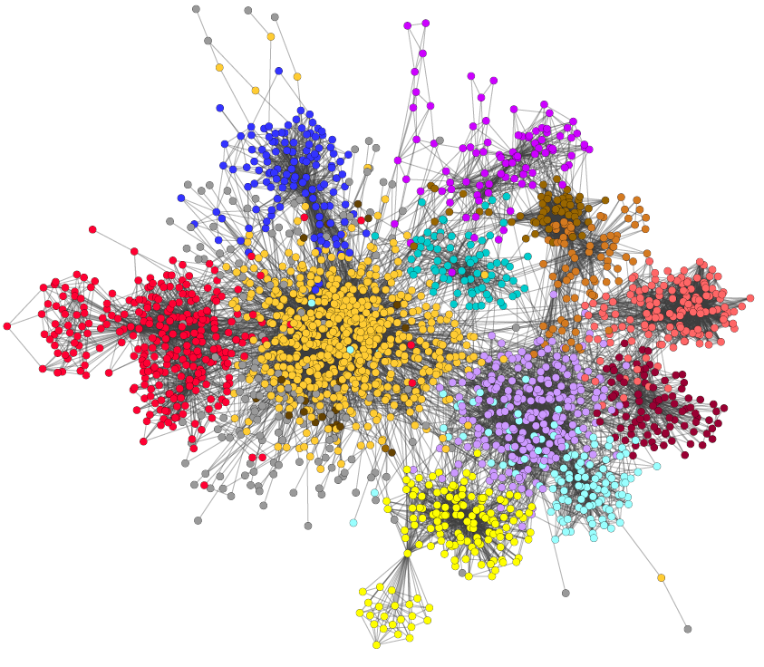
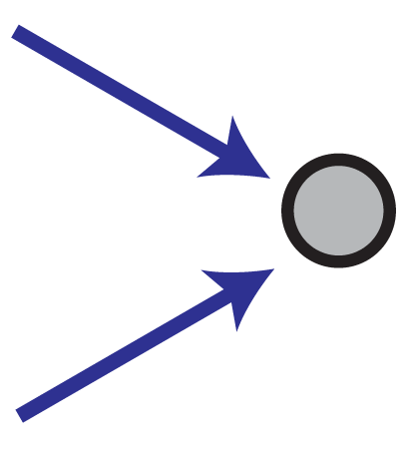


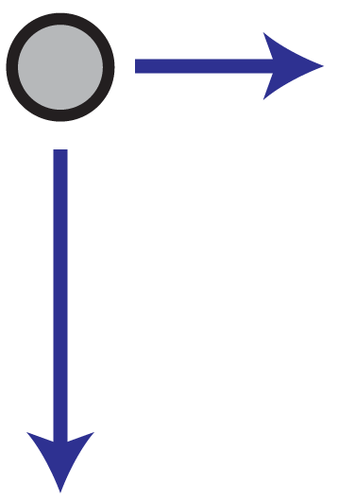
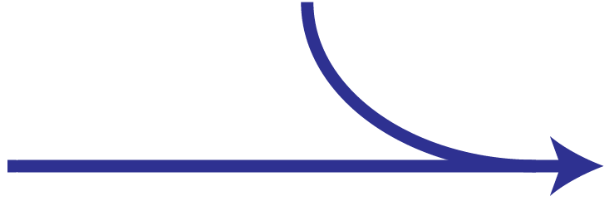

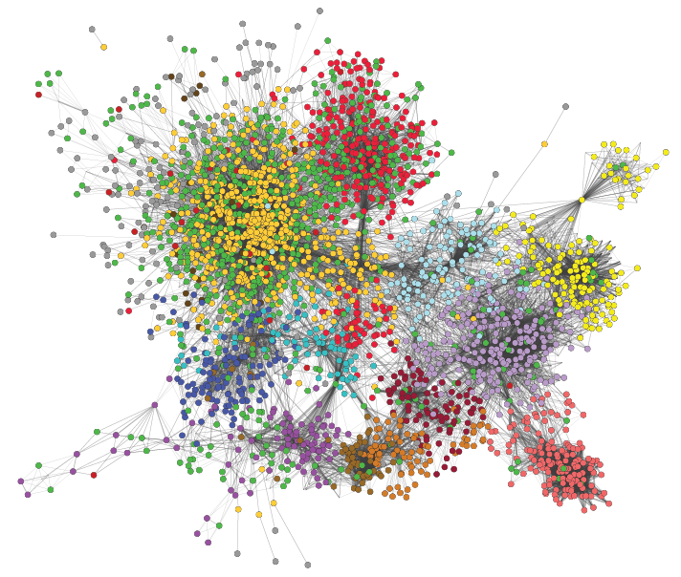

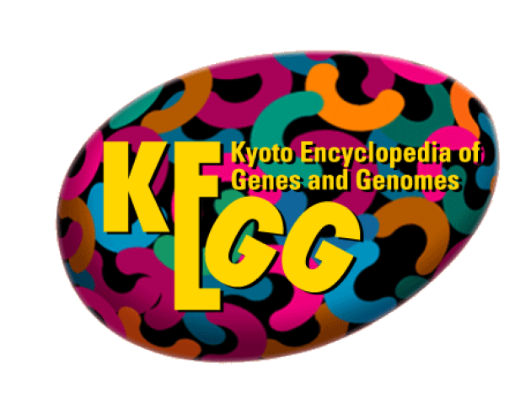


Metabolic model (GEM)
Enzyme usage: e
[mmol/gDW]
e ≤ [E]
E
Enzyme-constrained model
Enzyme data
A
B
Flux: v [mmol/gDWh]
Proteomics
(optional)
New stoichiometry: A + 1/k_{cat} E → B
Mass balance for E: v ≤ k_{cat} · [E]
Sánchez, B. J., Zhang, C., Nilsson, A., Lahtvee, P., Kerkhoven, E. J., & Nielsen, J. (2017). Molecular Systems Biology, 13(8), 935. https://doi.org/10.15252/msb.20167411

Slide 13
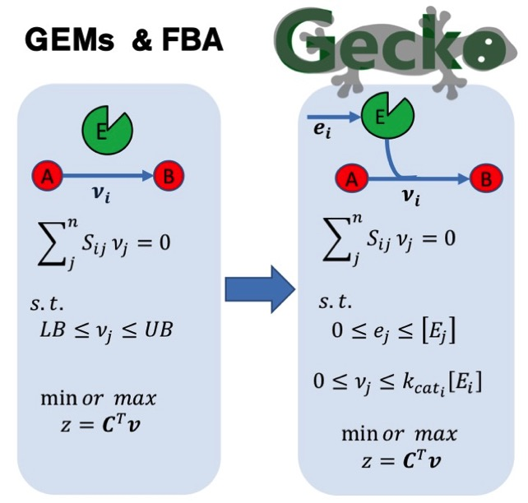
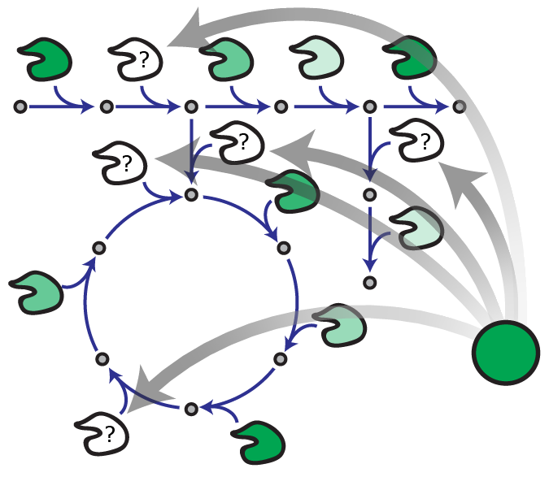
A simple mathematical framework

Slide 14
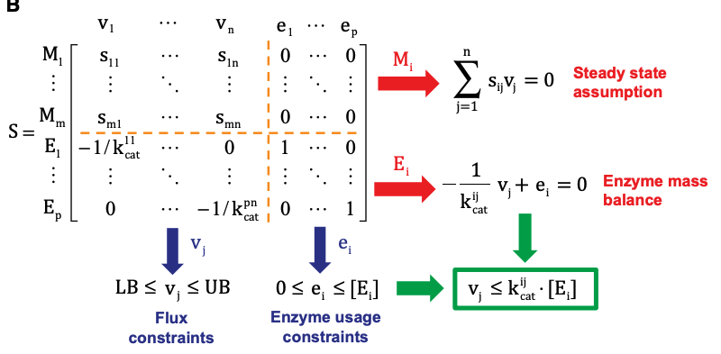
Matrix form

Slide 15
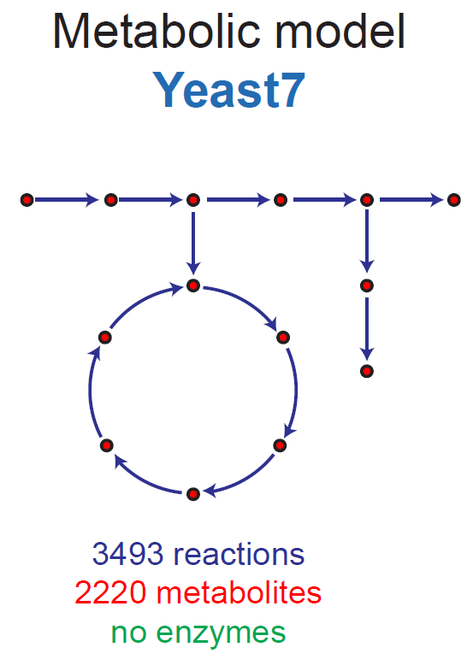
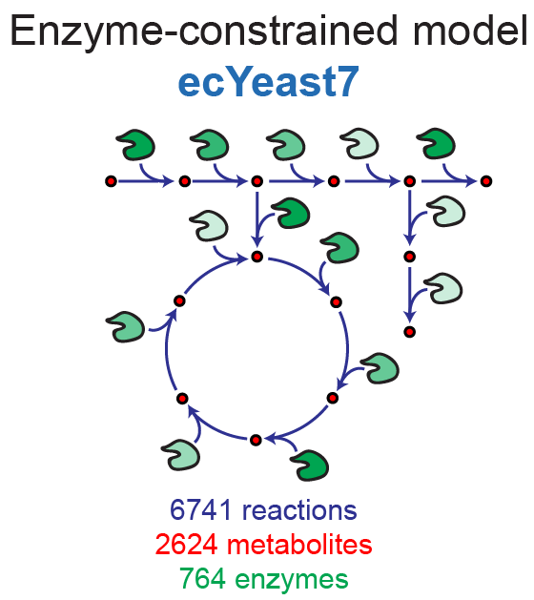

ecYeast7: an improved model of S. cerevisiae

Slide 16
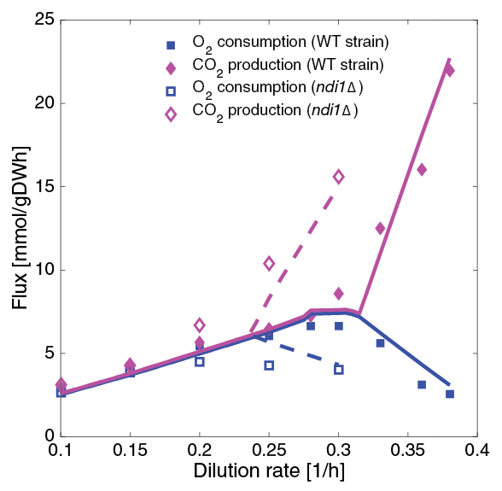
Improving phenotype predictions
Respiration/fermentation switch (in WT and knockout): chemostat simulations
Notes:
NDI1: Rotenone-insensitive NADH-ubiquinone oxidoreductase, mitochondrial.
NADH + ubiquinone = NAD⁺ + ubiquinol

Slide 17
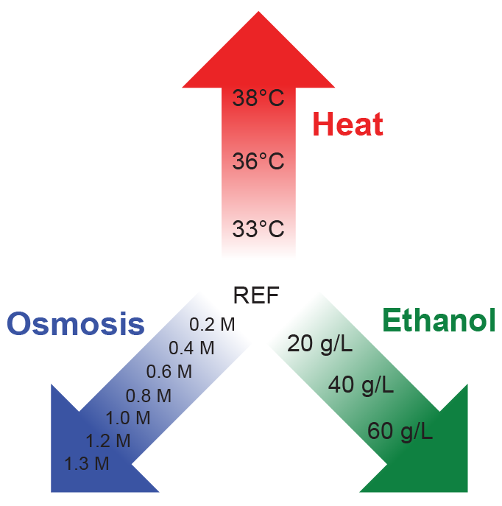
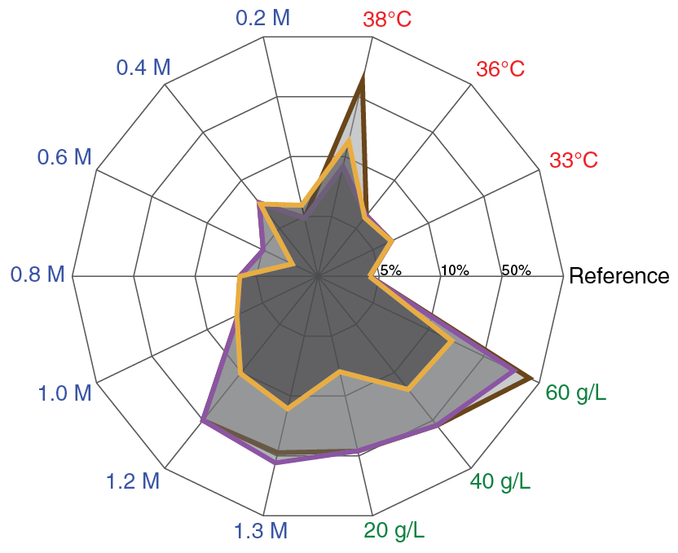
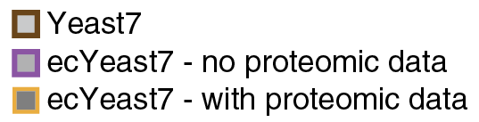
Integrating proteomics
Stress dataset:
S. cerevisiae grown at 14 different stress conditions
Glucose-limited aerobic chemostats @ 0.1 1/h
Proteomic data gathered for each condition
Created condition-specific models:
Error [%] in predicting exchange fluxes:
Notes:
Fitted NGAMs:
Ref: 1 – 1 – 1
33C: 1 – 1 – 1
36C: 1 – 1 – 1
38C: 25 – 31 – 10
0.2M: 1 – 1 – 0
0.4M: 0 – 0 – 0
0.6M: 5 – 5 – 5
0.8M: 6 – 6 – 6
1.0M: 11 – 11 – 7
1.2M: 14 – 14 – 8
1.3M: 15 – 27 – 10
20g/L: 1 – 1 – 3
40g/L: 0 – 0 – 5
60g/L: 0 – 23 – 3

Slide 18
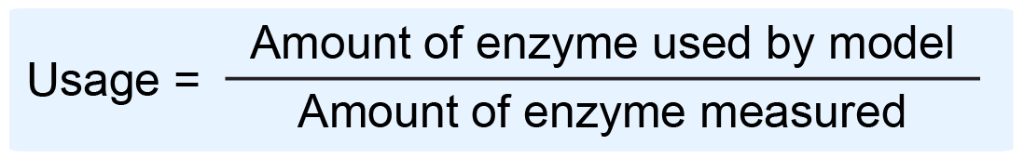
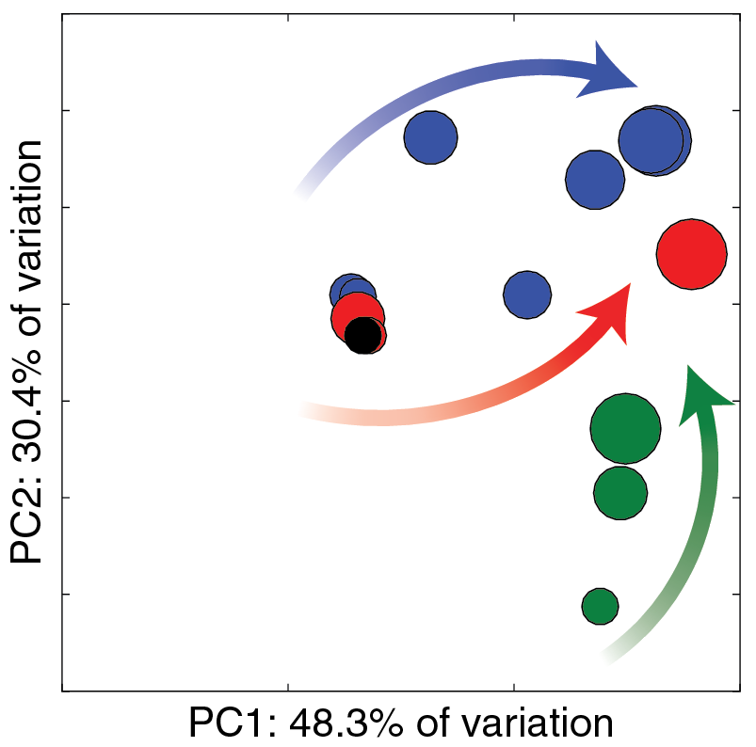
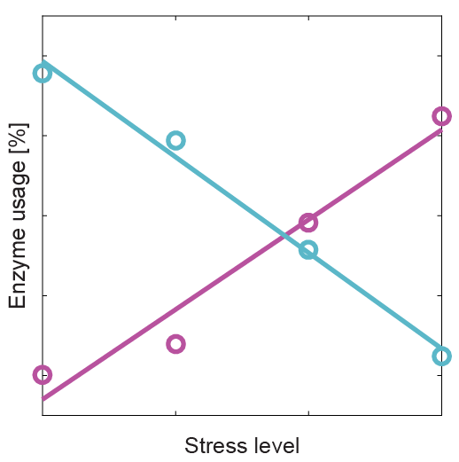
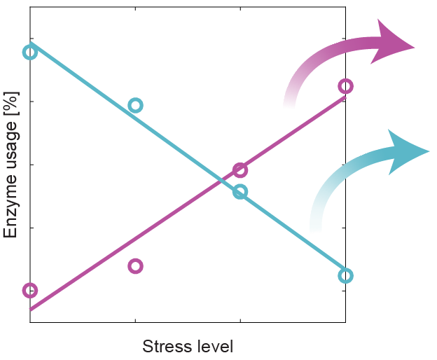
Applications: enzyme usage under stress
Enzyme usage: Can be expressed in absolute terms (mmol/gDW) or as a fraction
General trends
NaCl
Enzyme-specific trends
Increased usage
Heat: LYS21; HIS5; ERG8; ILV3
Osmosis: NDI1; ARO3; CIT1; ILV
Ethanol: MLS1; PYK2; HIS5
Heat
Decreased usage
Heat: GLN4; ADE5,7; UGP1; APA1
Osmosis: ADE5,7; ADE4; ADE2
Ethanol: UGP1
EtOH
Converging trend: Increased CCM and aminoacid degradation
Notes:
Filter: |correlation| > 0.95, m > 0.1, max(usage) > 1%
Increase Heat:
LYS21: L-lysine synthesis (Homocitrate synthase, mitochondrial )
HIS5: L-histidine synthesis (Histidinol-phosphate aminotransferase)
ERG8;13: Ergosterol synthesis (Phosphomevalonate kinase; HMG-CoA synthase)
ILV3;5: L-isoleucine synthesis (Dihydroxy-acid dehydratase; Ketol-acid reductoisomerase)
Decrease Heat:
GLN4: Glutamine--tRNA ligase (ATP + L-glutamine + tRNA(Gln) = AMP + diphosphate + L-glutaminyl-tRNA(Gln))
ADE5,7: IMP biosynthesis via de novo pathway (bifunctional purine biosynthetic protein))
UGP1: carbohydrate synthesis (UTP + alpha-D-glucose 1-phosphate = diphosphate + UDP-glucose)
APA1: ADP + ATP = phosphate + P₁,P(4)-bis(5'-adenosyl) tetraphosphate
Increase Osmosis:
NDI1: “Complex I”, NADH-ubiquinone oxidoreductase, mitochondrial (NADH + ubiquinone = NAD⁺ + ubiquinol)
ARO3: 1st step aromatic synthesis (PEP+ D-ery 4P + H₂O = 3-deoxy-D-arabino-hept-2-ulosonate 7P + P)
CIT1: Citrate synthase (Acetyl-CoA + H₂O + oxaloacetate = citrate + CoA)
ILV2;5: L-isoleucine synthesis (Acetolactate synthase; Ketol-acid reductoisomerase)
Decrease Osmosis:
ADE: IMP biosynthesis via de novo pathway:
ADE2: P-ribosylaminoimidazole carboxylase
ADE4: amido-P-ribosyltransferase
ADE5,7: bifunctional purine biosynthetic protein)
Increase Ethanol:
MLS1: TCA (Malate synthase)
PYK2: Pyruvate kinase (ATP + pyruvate = ADP + PEP)
HIS5: L-histidine synthesis (Histidinol-phosphate aminotransferase)
Decrease Ethanol:
UGP1: carbohydrate synthesis (UTP + alpha-D-glucose 1-phosphate = diphosphate + UDP-glucose)

Slide 19
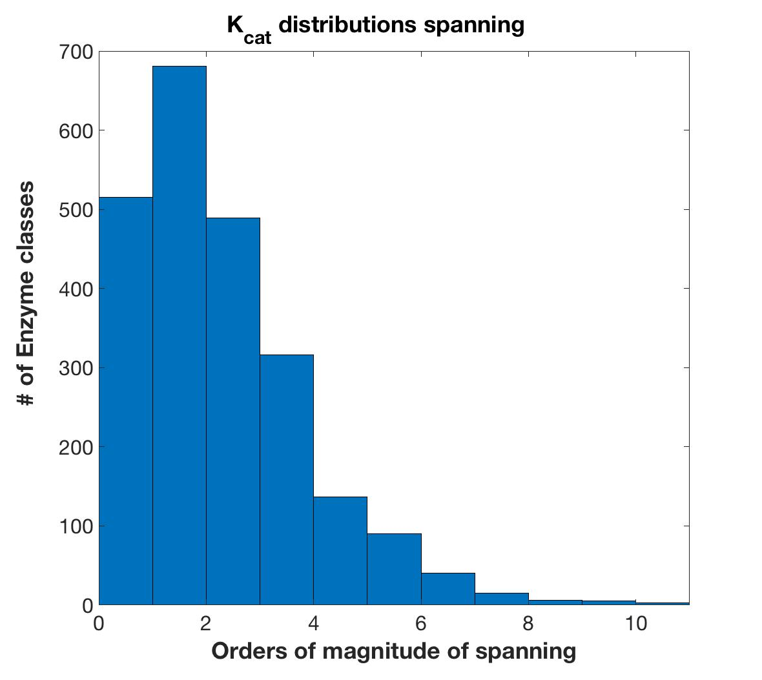

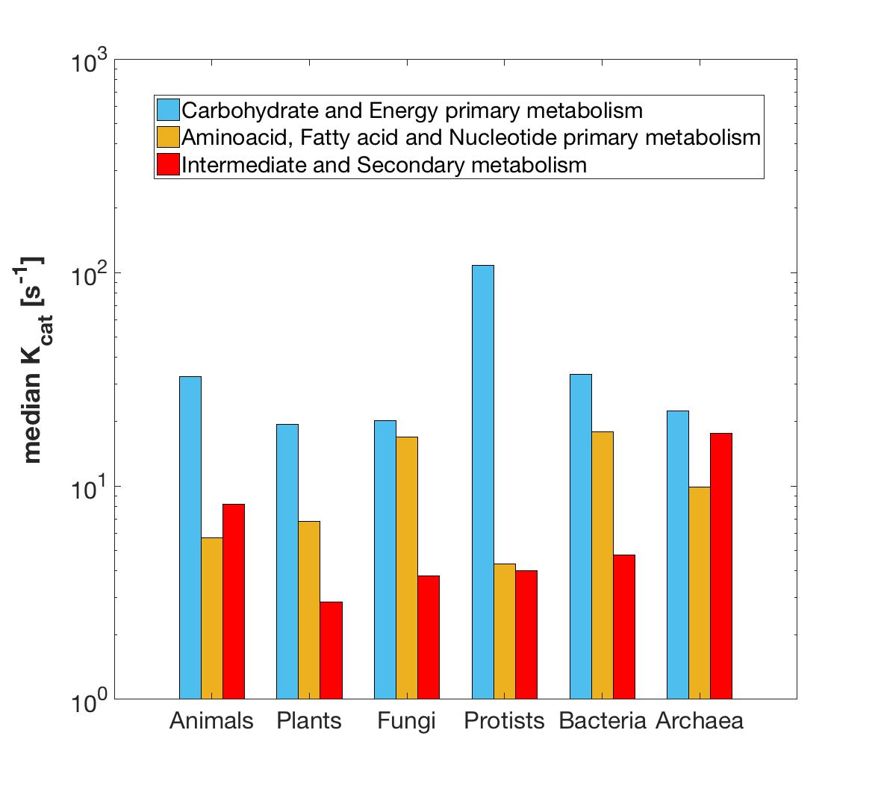
OK for yeast, but what about other bugs?
Notes:
Filter: |correlation| > 0.95, m > 0.1, max(usage) > 1%
Increase Heat:
LYS21: L-lysine synthesis (Homocitrate synthase, mitochondrial )
HIS5: L-histidine synthesis (Histidinol-phosphate aminotransferase)
ERG8;13: Ergosterol synthesis (Phosphomevalonate kinase; HMG-CoA synthase)
ILV3;5: L-isoleucine synthesis (Dihydroxy-acid dehydratase; Ketol-acid reductoisomerase)
Decrease Heat:
GLN4: Glutamine--tRNA ligase (ATP + L-glutamine + tRNA(Gln) = AMP + diphosphate + L-glutaminyl-tRNA(Gln))
ADE5,7: IMP biosynthesis via de novo pathway (bifunctional purine biosynthetic protein))
UGP1: carbohydrate synthesis (UTP + alpha-D-glucose 1-phosphate = diphosphate + UDP-glucose)
APA1: ADP + ATP = phosphate + P₁,P(4)-bis(5'-adenosyl) tetraphosphate
Increase Osmosis:
NDI1: “Complex I”, NADH-ubiquinone oxidoreductase, mitochondrial (NADH + ubiquinone = NAD⁺ + ubiquinol)
ARO3: 1st step aromatic synthesis (PEP+ D-ery 4P + H₂O = 3-deoxy-D-arabino-hept-2-ulosonate 7P + P)
CIT1: Citrate synthase (Acetyl-CoA + H₂O + oxaloacetate = citrate + CoA)
ILV2;5: L-isoleucine synthesis (Acetolactate synthase; Ketol-acid reductoisomerase)
Decrease Osmosis:
ADE: IMP biosynthesis via de novo pathway:
ADE2: P-ribosylaminoimidazole carboxylase
ADE4: amido-P-ribosyltransferase
ADE5,7: bifunctional purine biosynthetic protein)
Increase Ethanol:
MLS1: TCA (Malate synthase)
PYK2: Pyruvate kinase (ATP + pyruvate = ADP + PEP)
HIS5: L-histidine synthesis (Histidinol-phosphate aminotransferase)
Decrease Ethanol:
UGP1: carbohydrate synthesis (UTP + alpha-D-glucose 1-phosphate = diphosphate + UDP-glucose)

Slide 20
OK for yeast, but what about other bugs?
Lessons from BRENDA
K_{cat} values are heterogeneously available and show a extremely high variability amongst organisms and metabolic contexts, limiting the applicability of the original method to other GEMs.
Notes:
Filter: |correlation| > 0.95, m > 0.1, max(usage) > 1%
Increase Heat:
LYS21: L-lysine synthesis (Homocitrate synthase, mitochondrial )
HIS5: L-histidine synthesis (Histidinol-phosphate aminotransferase)
ERG8;13: Ergosterol synthesis (Phosphomevalonate kinase; HMG-CoA synthase)
ILV3;5: L-isoleucine synthesis (Dihydroxy-acid dehydratase; Ketol-acid reductoisomerase)
Decrease Heat:
GLN4: Glutamine--tRNA ligase (ATP + L-glutamine + tRNA(Gln) = AMP + diphosphate + L-glutaminyl-tRNA(Gln))
ADE5,7: IMP biosynthesis via de novo pathway (bifunctional purine biosynthetic protein))
UGP1: carbohydrate synthesis (UTP + alpha-D-glucose 1-phosphate = diphosphate + UDP-glucose)
APA1: ADP + ATP = phosphate + P₁,P(4)-bis(5'-adenosyl) tetraphosphate
Increase Osmosis:
NDI1: “Complex I”, NADH-ubiquinone oxidoreductase, mitochondrial (NADH + ubiquinone = NAD⁺ + ubiquinol)
ARO3: 1st step aromatic synthesis (PEP+ D-ery 4P + H₂O = 3-deoxy-D-arabino-hept-2-ulosonate 7P + P)
CIT1: Citrate synthase (Acetyl-CoA + H₂O + oxaloacetate = citrate + CoA)
ILV2;5: L-isoleucine synthesis (Acetolactate synthase; Ketol-acid reductoisomerase)
Decrease Osmosis:
ADE: IMP biosynthesis via de novo pathway:
ADE2: P-ribosylaminoimidazole carboxylase
ADE4: amido-P-ribosyltransferase
ADE5,7: bifunctional purine biosynthetic protein)
Increase Ethanol:
MLS1: TCA (Malate synthase)
PYK2: Pyruvate kinase (ATP + pyruvate = ADP + PEP)
HIS5: L-histidine synthesis (Histidinol-phosphate aminotransferase)
Decrease Ethanol:
UGP1: carbohydrate synthesis (UTP + alpha-D-glucose 1-phosphate = diphosphate + UDP-glucose)

Slide 21

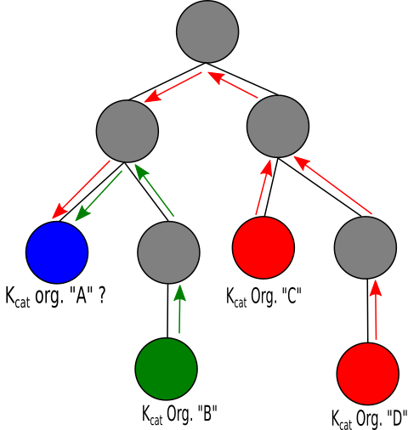
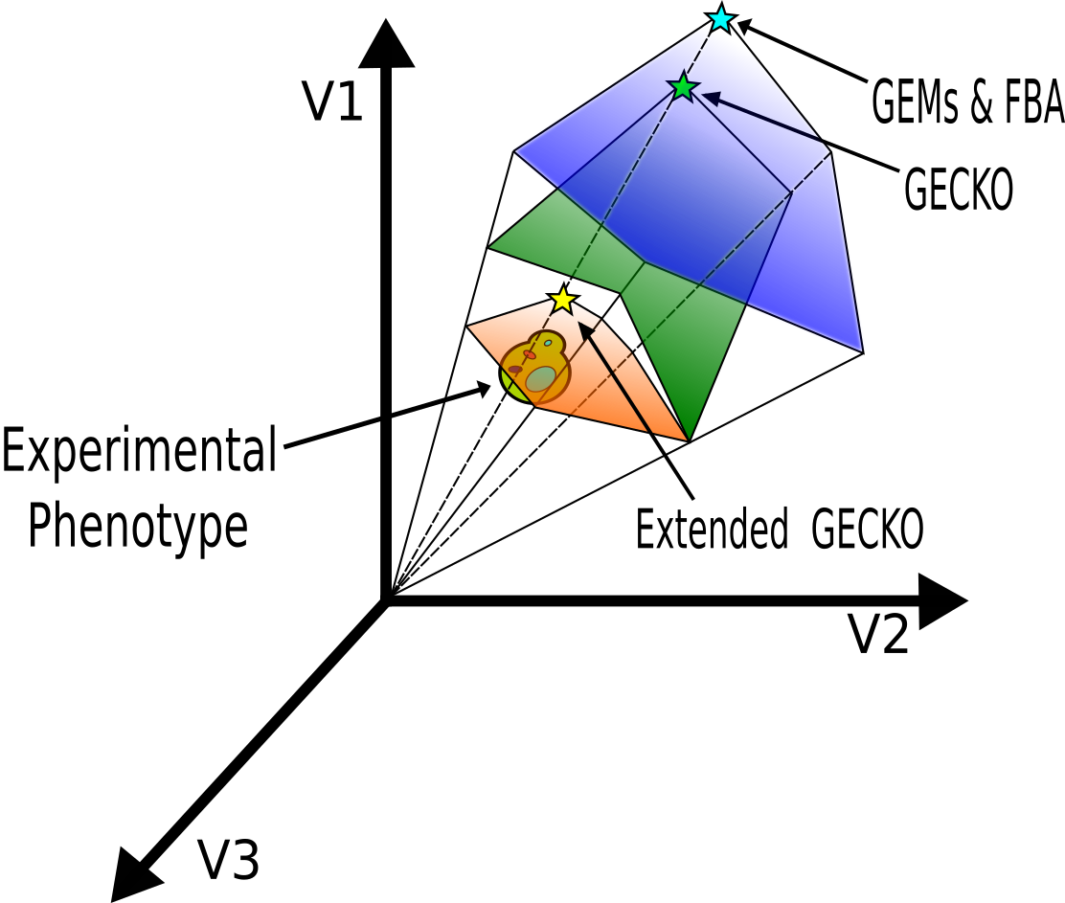

Moving forward
Automatic generation of functional and calibrated ecModel for any organism for which a GEM is available with minimal human intervention
Notes:
Filter: |correlation| > 0.95, m > 0.1, max(usage) > 1%
Increase Heat:
LYS21: L-lysine synthesis (Homocitrate synthase, mitochondrial )
HIS5: L-histidine synthesis (Histidinol-phosphate aminotransferase)
ERG8;13: Ergosterol synthesis (Phosphomevalonate kinase; HMG-CoA synthase)
ILV3;5: L-isoleucine synthesis (Dihydroxy-acid dehydratase; Ketol-acid reductoisomerase)
Decrease Heat:
GLN4: Glutamine--tRNA ligase (ATP + L-glutamine + tRNA(Gln) = AMP + diphosphate + L-glutaminyl-tRNA(Gln))
ADE5,7: IMP biosynthesis via de novo pathway (bifunctional purine biosynthetic protein))
UGP1: carbohydrate synthesis (UTP + alpha-D-glucose 1-phosphate = diphosphate + UDP-glucose)
APA1: ADP + ATP = phosphate + P₁,P(4)-bis(5'-adenosyl) tetraphosphate
Increase Osmosis:
NDI1: “Complex I”, NADH-ubiquinone oxidoreductase, mitochondrial (NADH + ubiquinone = NAD⁺ + ubiquinol)
ARO3: 1st step aromatic synthesis (PEP+ D-ery 4P + H₂O = 3-deoxy-D-arabino-hept-2-ulosonate 7P + P)
CIT1: Citrate synthase (Acetyl-CoA + H₂O + oxaloacetate = citrate + CoA)
ILV2;5: L-isoleucine synthesis (Acetolactate synthase; Ketol-acid reductoisomerase)
Decrease Osmosis:
ADE: IMP biosynthesis via de novo pathway:
ADE2: P-ribosylaminoimidazole carboxylase
ADE4: amido-P-ribosyltransferase
ADE5,7: bifunctional purine biosynthetic protein)
Increase Ethanol:
MLS1: TCA (Malate synthase)
PYK2: Pyruvate kinase (ATP + pyruvate = ADP + PEP)
HIS5: L-histidine synthesis (Histidinol-phosphate aminotransferase)
Decrease Ethanol:
UGP1: carbohydrate synthesis (UTP + alpha-D-glucose 1-phosphate = diphosphate + UDP-glucose)

Slide 22
A collection of ecModels
Enzymes coverage varies due to differences in functional annotation.

Slide 23
Reducing the solution space - FVA
-Median flux variability reduced in orders magnitude
-Number of totally variable fluxes is drastically reduced

Slide 24
Reducing the solution space - FVA
K. marxianus
1
-
0.75
Model
ecModel
0.5
0.25
0
10⁻²
10⁰
10²

Slide 25
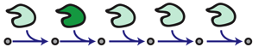
Applications: exploring mutant phenotypes
Gene deletions
Gene overexpressions
ecModels provide a natural framework for the exploration of enzymes deletion and overexpression effects on metabolism

Slide 26

Applications: exploring mutant phenotypes
Complex enzyme(s)-rxn(s) relationships are taken into accouOptimal expression levels for production targets can be assessed.
nt.
Gene deletions
Gene overexpressions

Slide 27
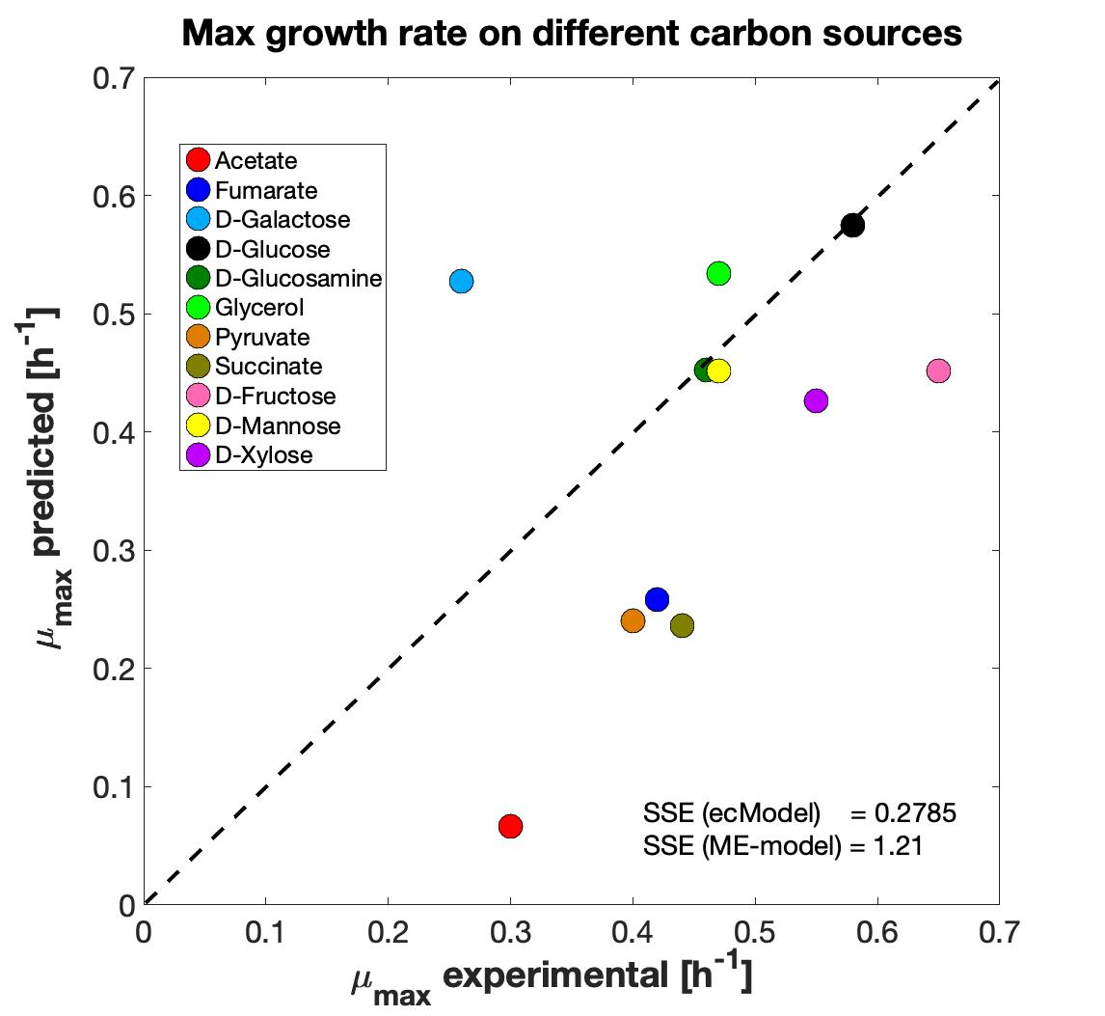
Applications: growth on diverse environments
E. coli
S. cerevisiae
E. coli
Total protein prediction
[g prot/gDw]
ecModels protein allocation compared to ME models
Growth predictions on diverse environments

Slide 28
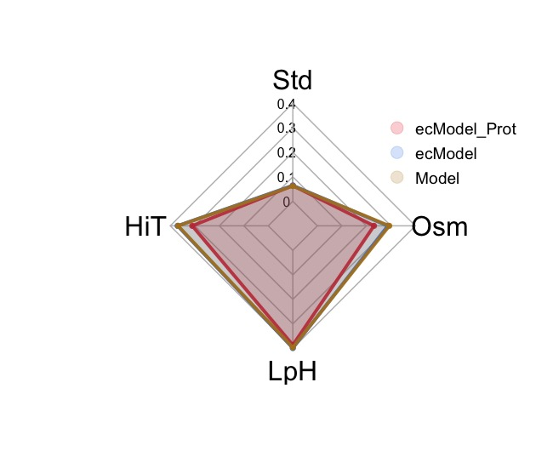
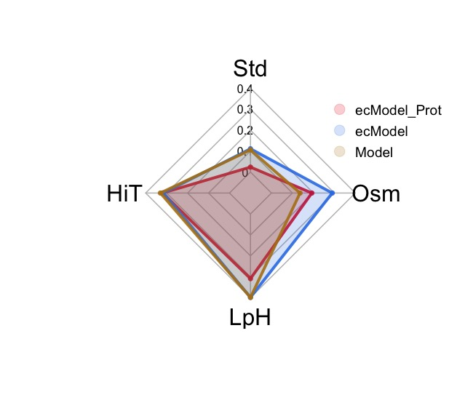
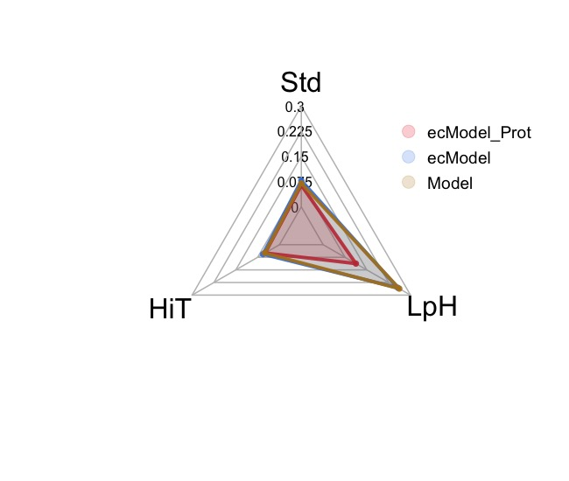
Applications: analyzing stress responses
Improving phenotype predictions by the addition of proteomics data for multiple conditions
S. cerevisiae
K. marxianus
Y. lipolytica
*Median relative error in exchange fluxes prediction

Slide 29
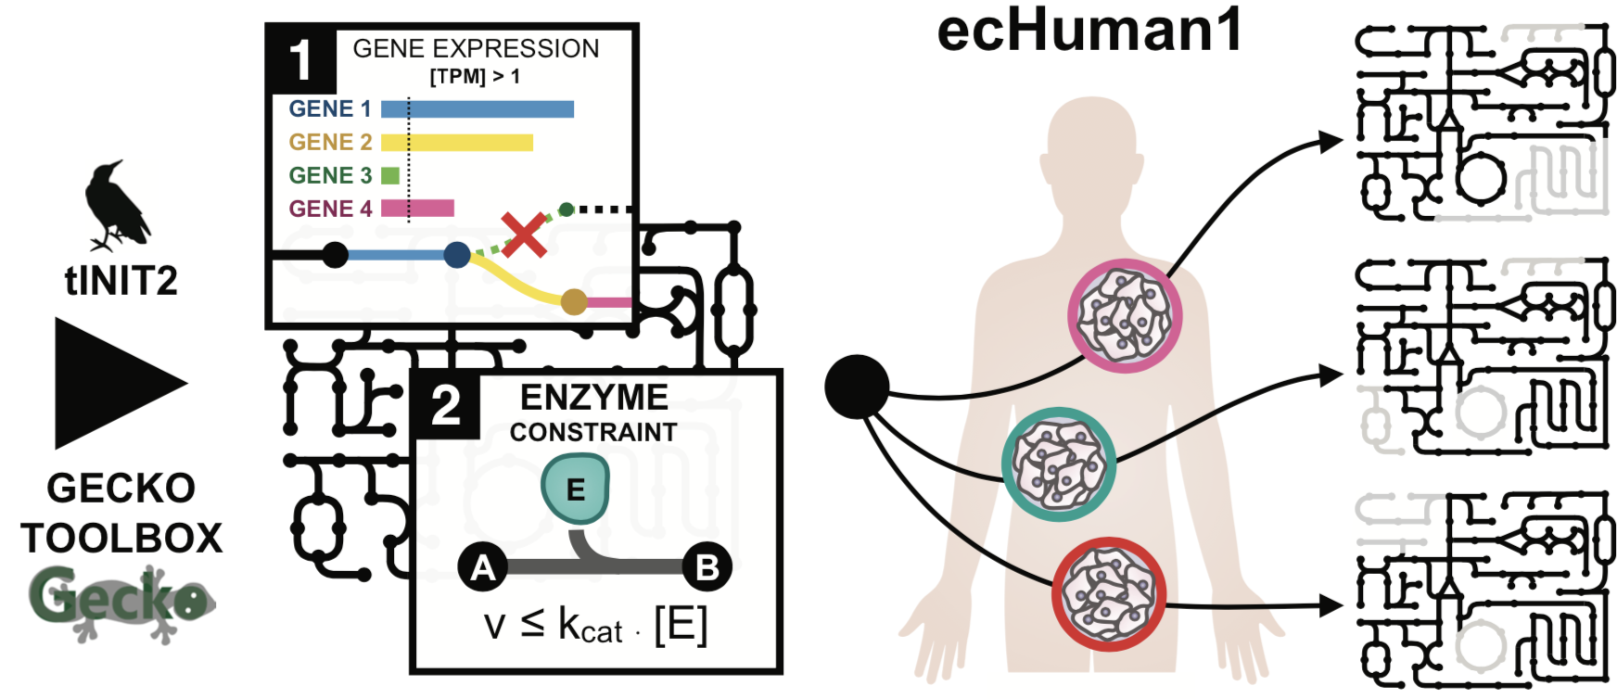
Applications: exploring Human metabolism
Generation of 11 human cell-lines ecModels through the incorporation of transcriptomics data and kinetic constraints

Slide 30
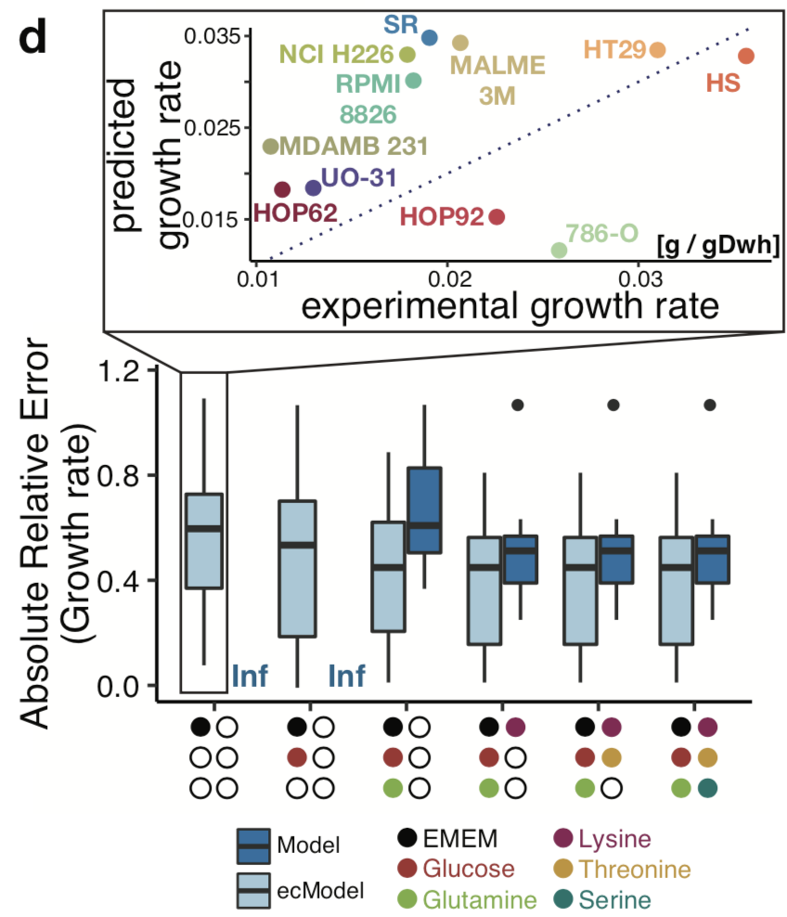
Applications: exploring Human metabolism
Generation of 11 human cell-lines ecModels through the incorporation of transcriptomics data and kinetic constraints
Predicting growth rates with minimal sets of exchange fluxes constraints

Slide 31

Summary
Enzyme limitation: Common among many experimental conditions. Important to model!
: A simple method for improving GEM predictions https://github.com/SysBioChalmers/GECKO
Enzyme usage: Useful for finding enzymes with an important role in metabolism

Slide 32
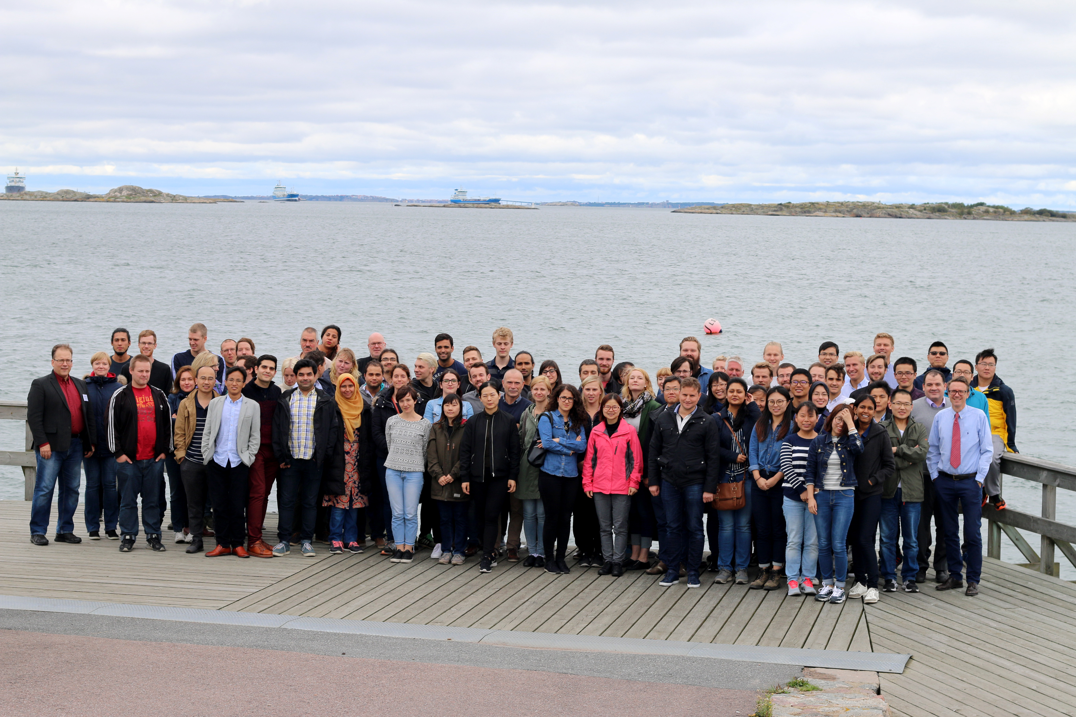

Acknowledgements
Jens Nielsen
Verena Siewers
Benjamín Sánchez
Raphael Ferreira
Eduard Kerkhoven
Simonas Marcisauskas
Tyler Doughty
Aarón Millán
Avlant Nilsson

